Slide 1
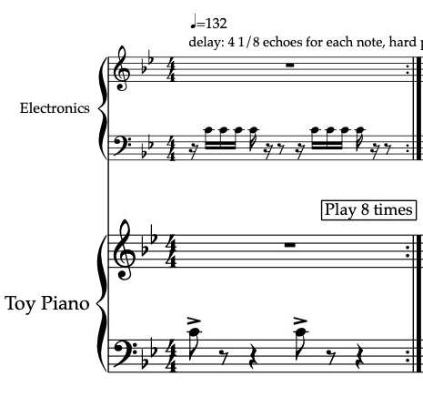
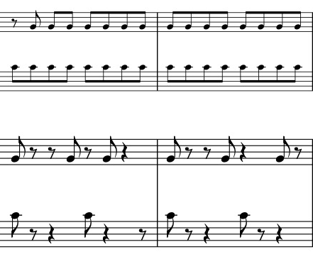

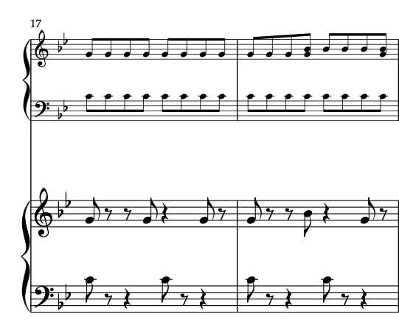
9

Slide 2
25
33
41

Slide 3
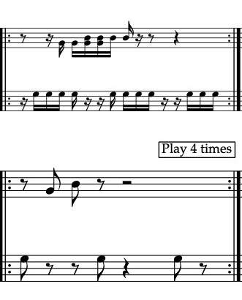
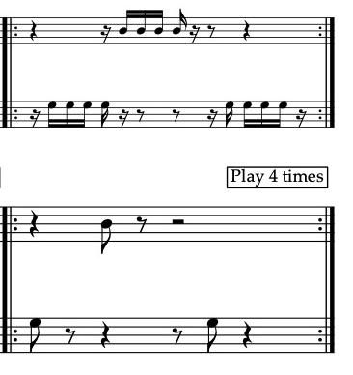

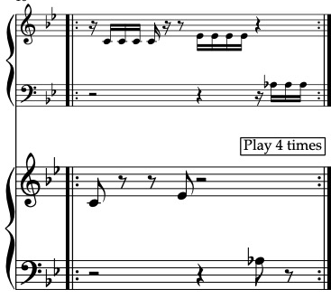
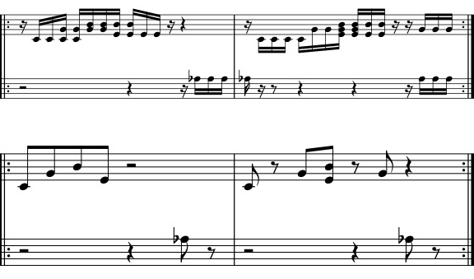
45
53
61
65
Sorry for wrong flags! Please correct

Slide 4
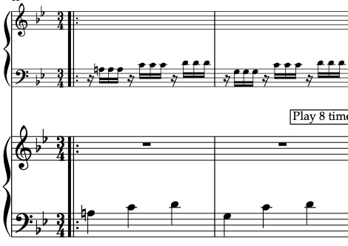
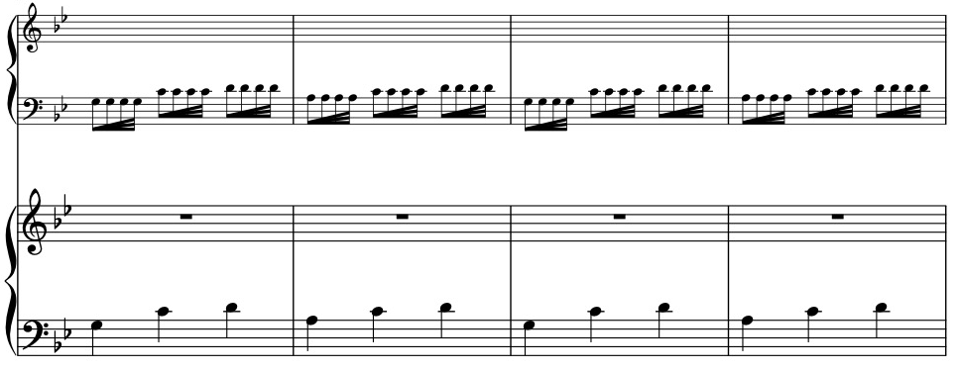





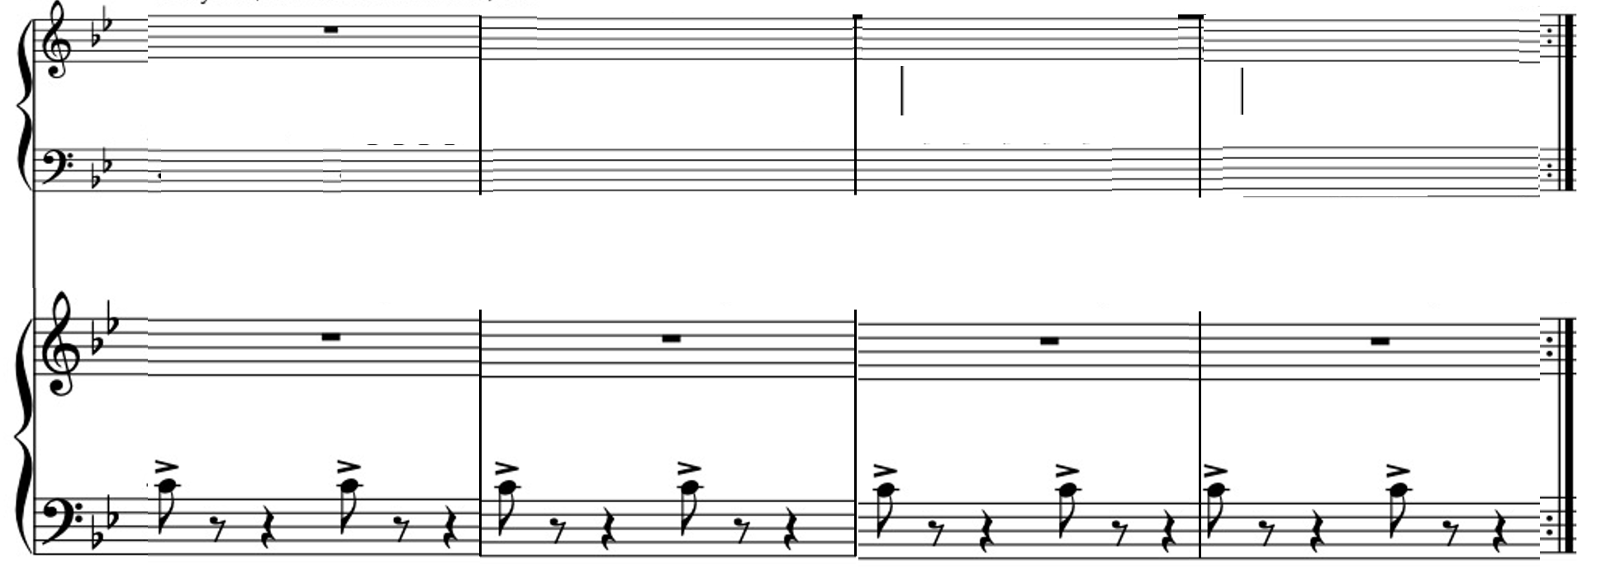


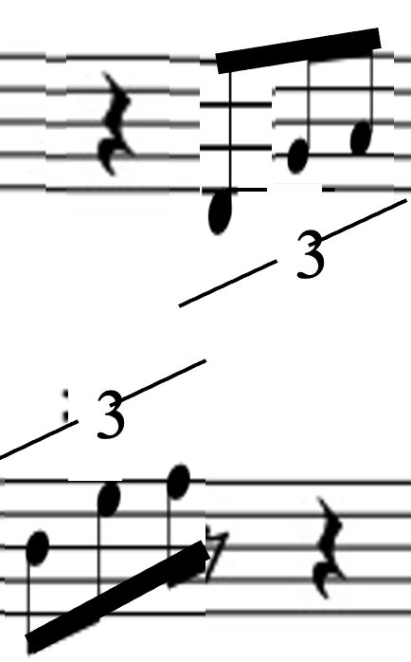
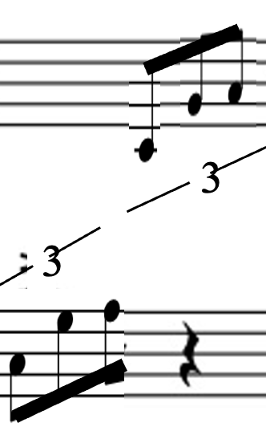



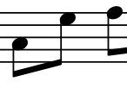
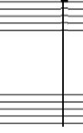



73
Change key to Cmaj
3
3
3
3
3
3
3
3
77
quarter note
No B natural reminder needed
quarter note
quarter note
3
3
3
3
3
3
3
3
85
3
3
3
3
93
Half-note triplets
3
3

Slide 5
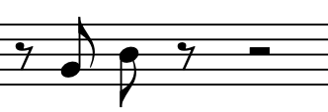


99
Half-note triplets
3
3
102
3
3
Half-note triplets
108
3
3
Half-note triplets

Slide 6
111
3
3
Half-note triplets
117
quarter note
E natural
quarter note
3
3
Half-note triplets
120
Half-note triplets
3
3
3

Slide 7


124
disregard these bar markers (this line has 5 measures)
Half-note triplets
2
4
3
2
4
129
133

Slide 8

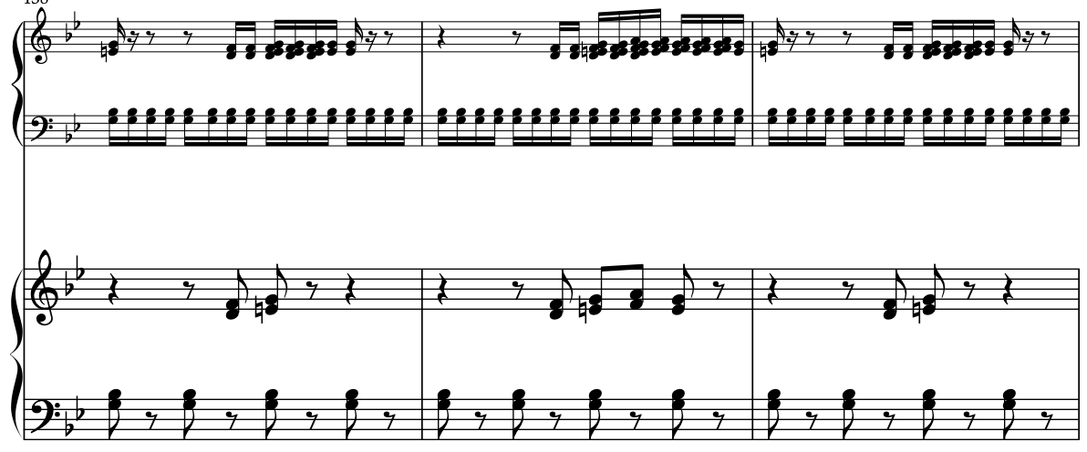
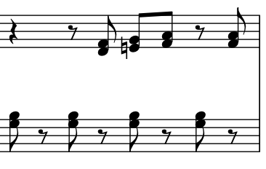
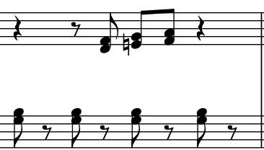
137
145
Disregard for now – I will correct this
149

Slide 9
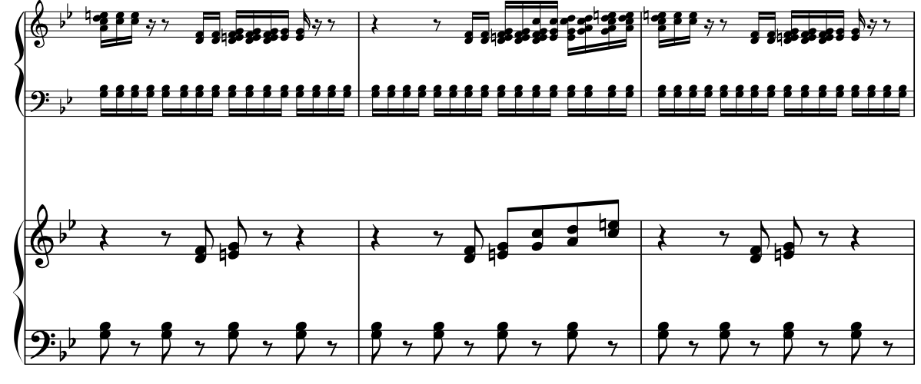
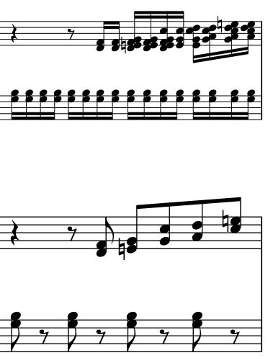
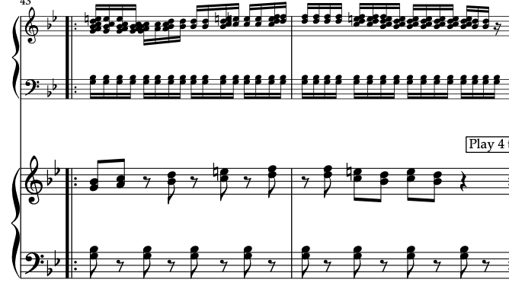
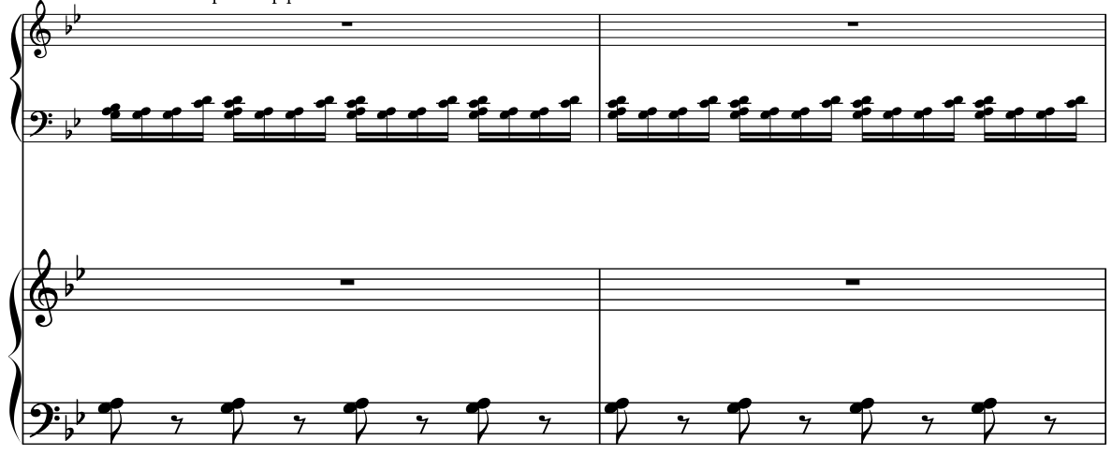
153
161
169
173
Crossed hands

Slide 10


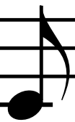



181
185
189
D C
193

Slide 11


197
201

Slide 12

Play 4 times
3
3
3
3

